Slide 1

Nemo
Factory database system

Slide 2
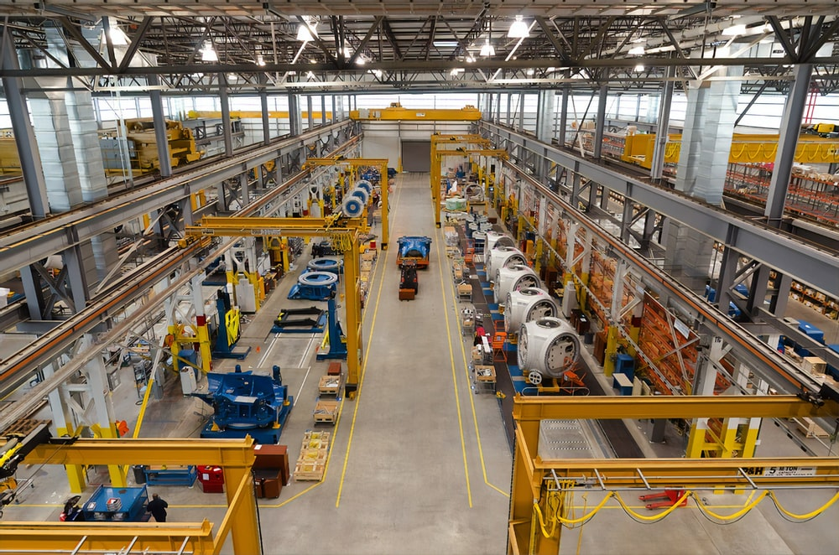
Aim
Control a complete Factory, starting from machine and worker to manager

Slide 3



It consists of
Supervisor
Worker
Manager

Slide 4

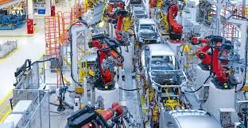
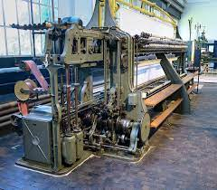
System
Machine
Product
Production Line

Slide 5
System
Worker
Machine
Works on

Slide 6
Production line
Supervisor
Production Line
Manages

Slide 7
Who is this for?
1- For any factory manager who wants to store data regarding employees,
Production lines, machines, for later manipulation
2- For anyone who wants to boost his work with high quality statistics.
3-For anyone who wants consistent and non-redundant data
4-For anyone who wants Good design and interactive system

Slide 8
Manager
Has access to everything
See overall statistics
Insert
Update
Delete

Slide 9
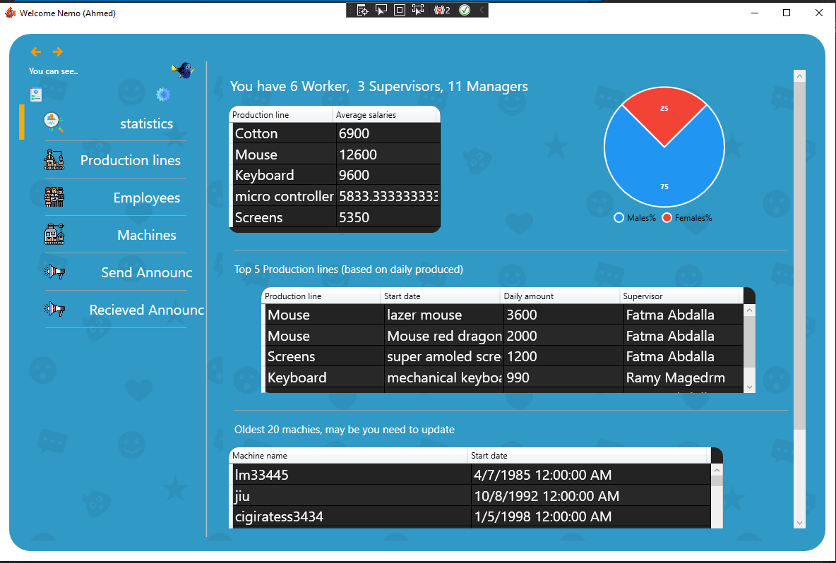
Statistics

Slide 10
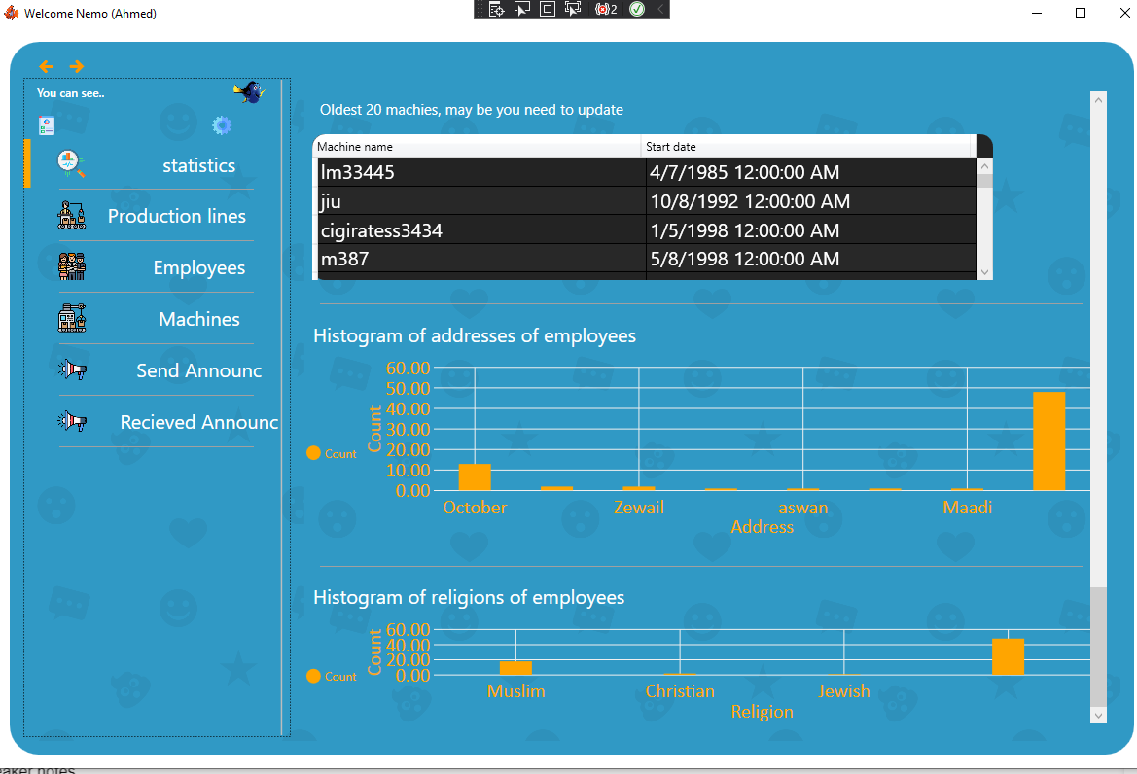
Statistics

Slide 11
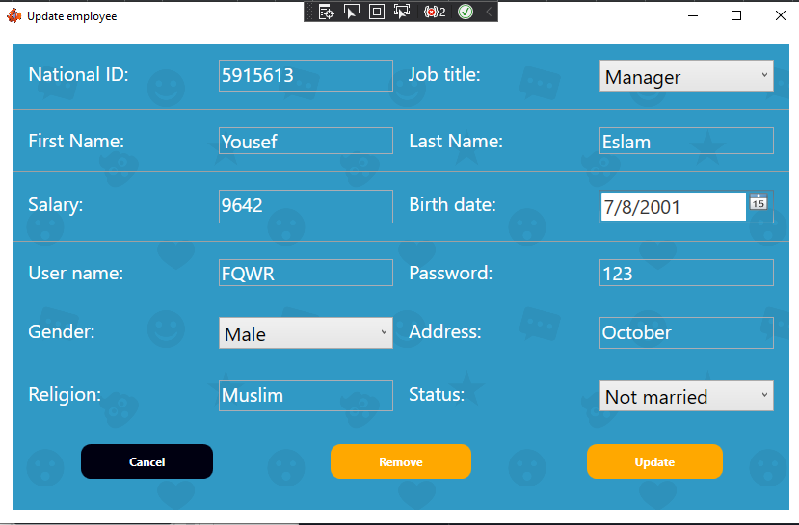
Update Employee

Slide 12
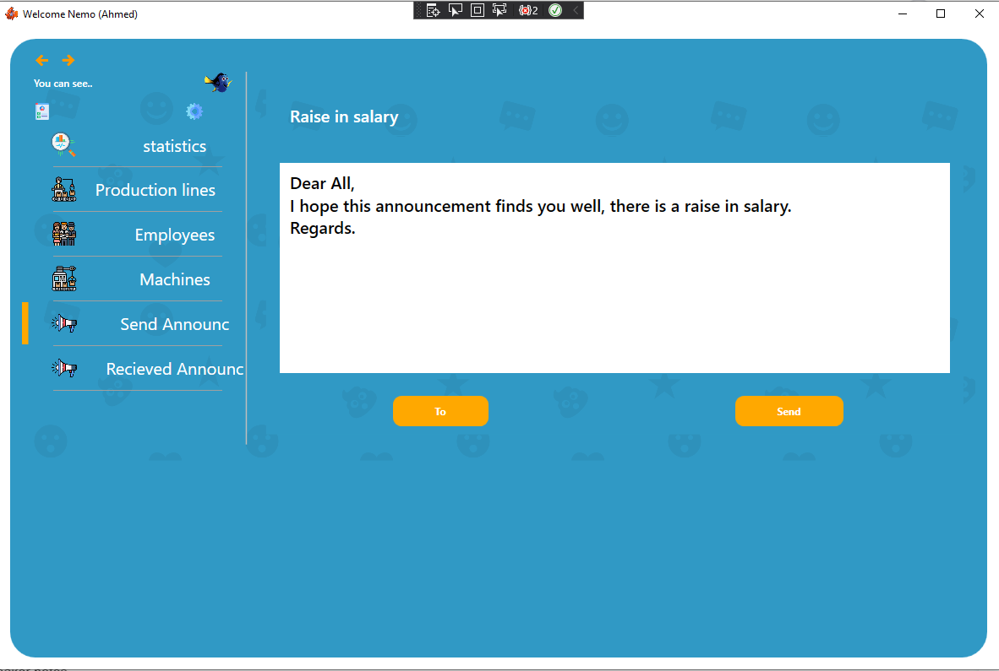
Send Announcements

Slide 13
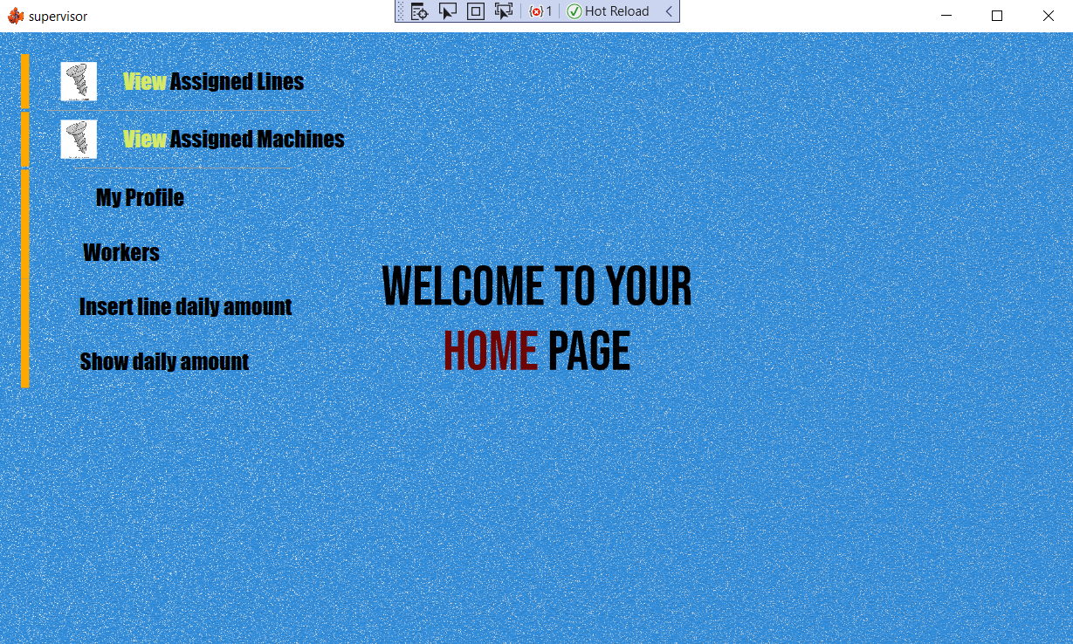
Supervisor main view

Slide 14
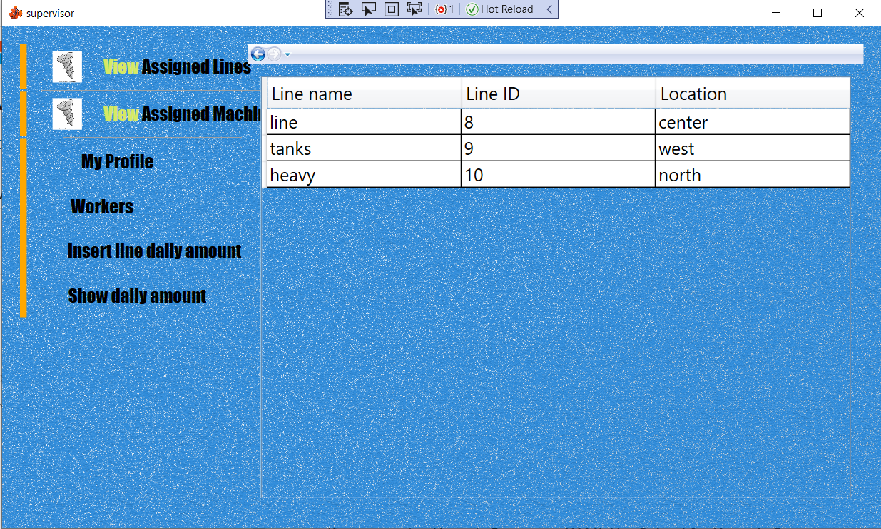
Option 1: view assigned lines

Slide 15
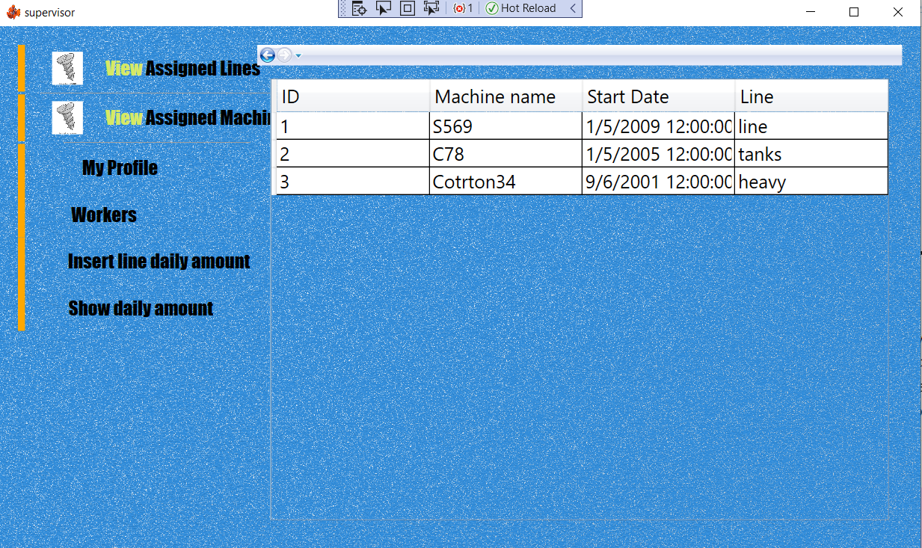
Option 2: view assigned machines

Slide 16
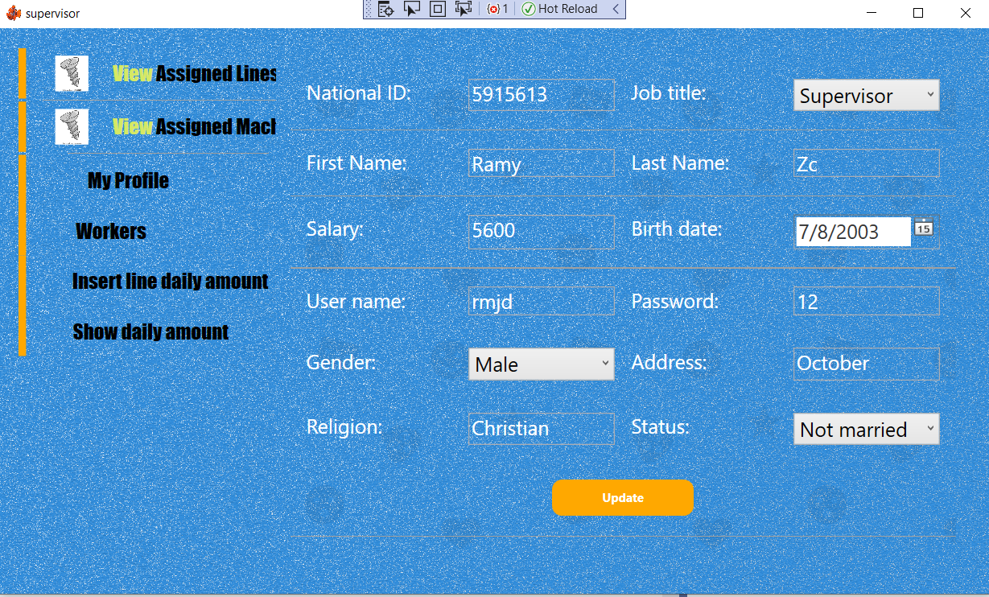
Option 3: view profile

Slide 17
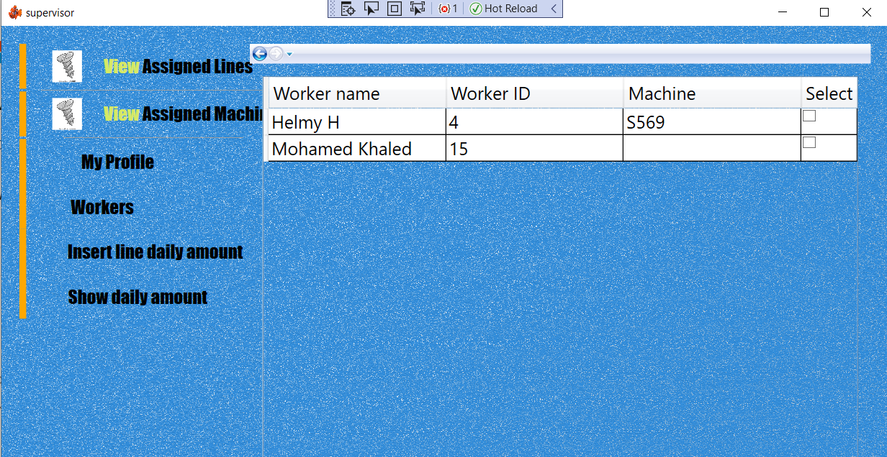
Option 4: view workers
note: supervisor can view workers assigned to him and workers who are not assigned yet to assign some of them if needed by selecting then a button will appear to choose a machine

Slide 18
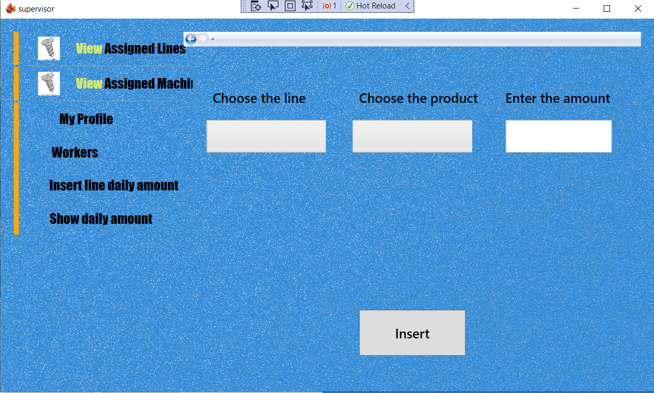
Option 5: Insert/update Daily production of a line
supervisor can view 2 drop down menus of his assigned lines and all the products
then enters the amount in the text box

Slide 19
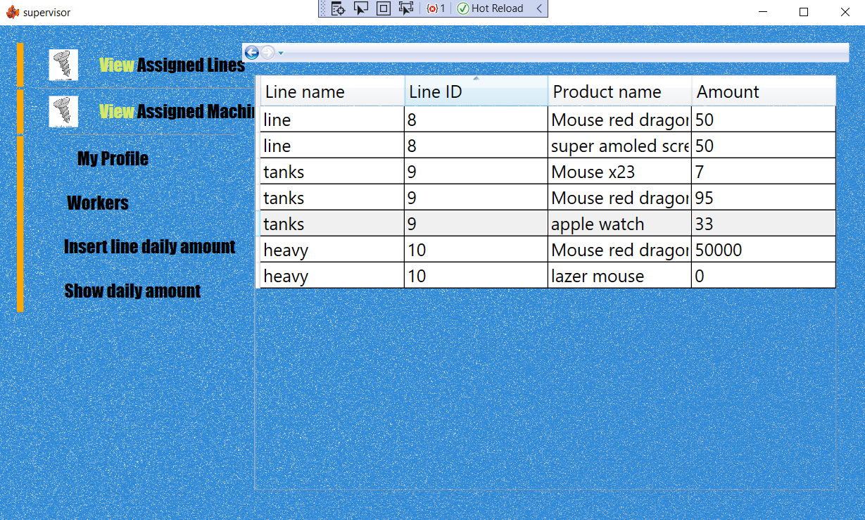
Option 6: view daily production amount of lines if exists

Slide 20
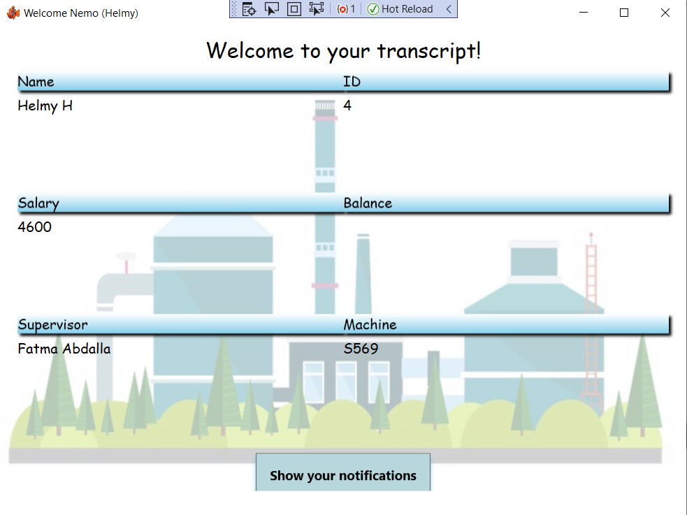
Worker Main View
Worker can view their transcript and can see any announcements from manager or supervisor

Slide 21
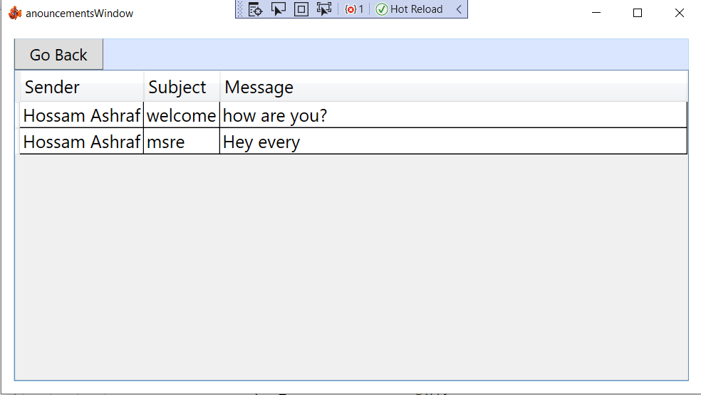
Worker notification window

Slide 22
Thanks

